Slide 1
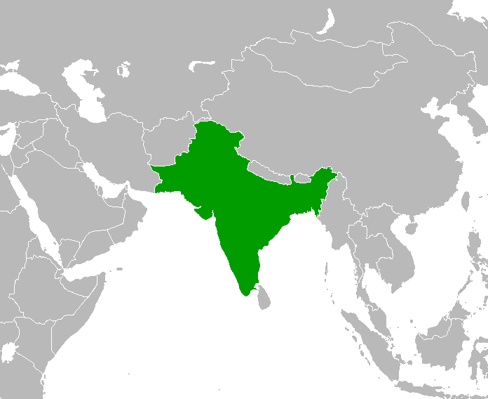
Indian Music
Scheme of work for KS3

Slide 2
India is a large country with many different languages and communities within it, the music we are going to look at is from North India, Pakistan & Bangladesh. The borders of these countries are relatively new and they have been joined or part of the same empire/state in the past.

Slide 3
North Indian music is from the redline upwards and the music below this line is known as Carnatic music which is very different from North Indian music.

Slide 4
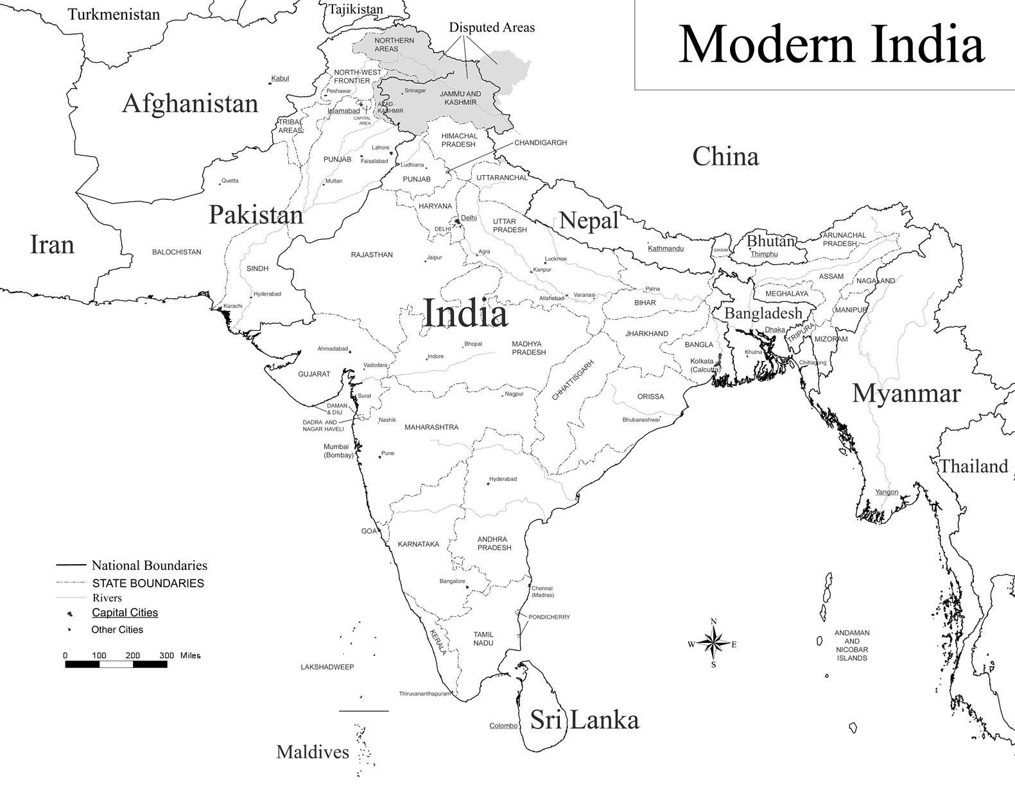
North Indian music is very old with it first being documented over 3000 years ago but as we know is today it started to emerge around 900 years ago. By 1500AD the Mughal empire which originated in Persia invaded North India but was stopped from travelling further south by the Vijayanagar empire and this is why there is a difference in North and South Indian music.

Slide 5
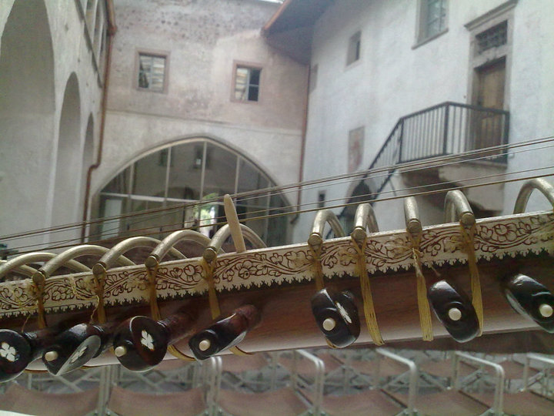
North Indian Instruments

Slide 6
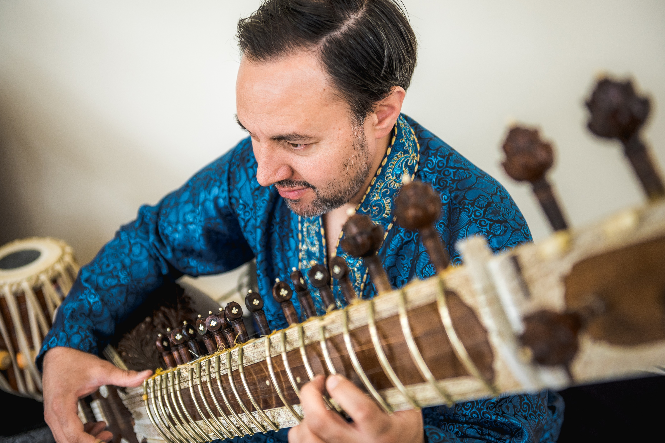
Sitar Short video on the sitar https://youtu.be/ppQ00OOVBzk

Slide 7
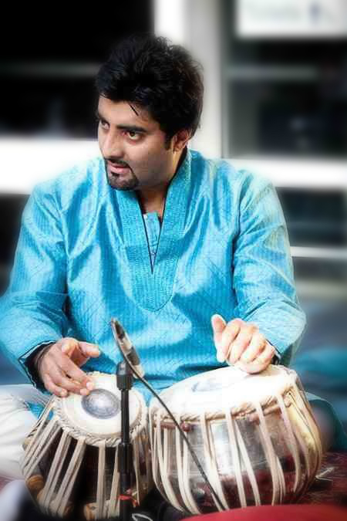
Tabla Short video on the tabla https://youtu.be/JvzXR9EEfgA

Slide 8
Other Indian instruments
Bansuri
Sarod
Sarangi
https://youtu.be/mnDVSvBFbwE
Above is a short video on the bansuri
The sarod is played, and looks more like a guitar. Just like the sitar is has around 20 strings and has a stainless steel fretboard which is played using your nails.
You will see an example of the sarod being played later on in this power point.
The sarangi is a bowed instrument which is played almost like a cello. It has around 35 strings, some made of gut. It is played my gliding your finger up and down the string.
You will see an example of the sarangi being played later on in this power point.

Slide 9
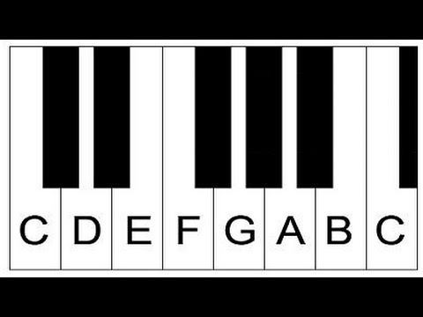
Raga
A raga is like a scale, a series of notes that go up and down, have a look at the notes of a keyboard and take the note C as your main note. This main note is called the tonic in western music and Sa in Indian music, will be the basis for our raga.

Slide 10
The notes
Western tradition uses the note names C,D,E,F,G,A,B like the keyboard image to the right.
In India we use different note names and although Sa can start on any note to make it easier to understand we are using C as a basis just like the previous slide
Here are the note names
Sa - C
Re - D
Ga - E
Ma - F
Pa - G
Dha - A
Ni - B

Slide 11
Ukulele Tuning
If you are using a ukulele instead of a keyboard you will find C by playing the second string without placing any of your fingers on the fretboard. So the notes are –
C/Sa = open 2nd string
D/Re = place finger on 2nd fret on 2nd string
E/Ga = place finger on 4th fret on 2nd string
F/Ma = place finger on 5th fret on 2nd string
G/Pa = place finger on 7th fret on 2nd string
A/Dha = place finger on 9th fret on 2nd string
B/Ni = place finger on 11th fret on 2nd string
C/Sa = place finger on the top fret on 2nd string
We are only using the 2nd string because a lot of Indian instruments only use one string to focus on the melody and gives the ability to glide between the notes easier.

Slide 12
The extra notes
We now know all the note names for the white notes but as you can see they are black notes as well. If we add all the black and white notes together from C to C we have 12 notes and so here are the full names. On your ukulele you would play all the frets in an upward order.
Sa - C
Re – D flat
Re - D
Ga – E flat
Ga - E
Ma - F
Ma – F sharp
Pa - G
Dha – A flat
Dha - A
Ni – B flat
Ni - B

Slide 13
How ragas are created
Using these note names we can combine them to create a raga.
The rules are that it must contain Sa (C) and you can not have Re (D flat) & Re (D) together in a raga and you can not have Dha (A flat) & Dha (A) together in a raga.
Here are a few examples of traditional ragas that have the same notes on the way up and down.
Bhairavi – Sa Re Ga Ma Pa Dha Ni Sa
Kafi – Sa Re Ga Ma Pa Dha Ni Sa
Charukesi – Sa Re Ga Ma Pa Dha Ni Sa
Bhairav – Sa Re Ga Ma Pa Dha Ni Sa

Slide 14
More Details on Raga
There is a bit more to a raga than it just being a scale. It is mostly improvised and we explore the notes to create the mood that is need.
Every raga has an important, and second important note and playing more of these notes can change the mood of the improvisation
Some ragas can use certain notes on the way up and different ones or omit ones on the way down.
Every raga should be performed at a specific time of day
Vadi = Most important note
Samvadi = Second most important note
Rasa = mood
There are ragas for all times of the day – Morning, midday, afternoon, late afternoon, dust, evening, late evening, midnight, early morning
The rasa of a raga is closely linked to the time of day it is performed

Slide 15
More details on raga
Most Indian instruments have the ability to slide between notes. In western tradition this is called glissando, in India they call it meend.
Have a listen to the clips to the left – one is vocals then the others are different instruments described earlier and they all try to imitate Indian vocals.
One thing to remember when listening is that all the music in the videos are mostly improvised.
Which mood do you think each video is trying to portray?
A raga performance can last over an hour, so that’s improvising on the same notes for that amount of time!
https://www.youtube.com/watch?v=PzCZomuHVVQ
Afternoon - vocals
https://www.youtube.com/watch?v=99i5rb2Je_8
Late evening - sitar
https://www.youtube.com/watch?v=IhRaW4kgKJw
Morning – sarangi
https://www.youtube.com/watch?v=lh7QxHhiHOM
Late night - sarod

Slide 16
Structure
Although North Indian classical music is mainly improvised there are set sections within the Raga performance
Alap – opening section with no sense of rhythm, it is the section where the performer can explore the notes of the raga
Jor – introduction of a pulse with increasing speed and intensity
Jhalla – Repetitive rhythmical pattern at a fast tempo
Gat or bandish – Introduction of tabla and is set to a tala (to be explained later). Gat or bandish means composition and is the part that isn’t improvised although a performer would only use this as a basis to improvise around. Gat is a composition for instruments and bandish a composition for vocals.

Slide 17
Drone
Drone is a very important element in Indian music and It is played by an instrument called tanpura which has between 4 & 6 strings. You can’t change any of the notes by pressing your finger on the string unlike the sitar or ukulele and it creates a continuous sound that acts as a backing for the solo instrument be it sitar, sarod, bansuri etc….
Here is a link to the tanpura being played and you can use this link as a backing for worksheet 1
https://youtu.be/5ogmqLGVEjk
Below is a video link describing the tanpura
https://youtu.be/8w3gJxkzp4o

Slide 18
Raga Bhupali
We are now going to look at a very simple Indian raga called Bhupali.
The notes are the same on the way up and the way down
C = Sa, D = Re, E = Ga, G = Pa, A = Dha
Vadi = Dha, samvadi = Ga

Slide 19
Worksheet One
Get in to pairs and follow worksheet one
Here is a link of an alap in Bhupali to give you an idea of what you will be trying the create.
https://youtu.be/2ZUoH6HXQiE

Slide 20
Tala
Rhythm is very important in Indian music and can be very complex.
The first thing to note is the way they count their rhythms –
Below is a sample of western notation and you can see that you read it just like a book, from left to right and this is how western music is counted and we can call it linear.
At the beginning there are two number 4’s, the top one refers to how many beats there are in a bar (a bar separated by bar lines and example above has four bars. The bottom one refers to how long each beat is and the number 4 refers to a crochet.

Slide 21
Tala
Indian music is cyclic which means the rhythm goes around and around. Below is an example of a rhythmical cycle called Teental which is 16 beats long. Here is a video explaining it in more detail. https://youtu.be/q5y1SCKzB6g
Practice clapping the rhythm as a class exercise, remember clap on 1, 5 & 13. 9 is the khali (empty)
1
13
5
9

Slide 22
Tala
There are many different rhythmical cycles or talas as we call them and they are composed by using sam (first beat), khali (empty beat) and matras (individual beats).
Dadra – 6 beats long
Rupak – 7 beats long
Keherwa – 8 beats long
Matta – 9 beats long
Japtal – 10 beats long
Ektal – 12 beats long
Dhamar – 14 beats long
Each one is divided differently for example Japtal is 2+3+2+3 and you would clap on these divisions excluding the khali just like Teental.
Here is an example of Japtal
https://youtu.be/IAmgK1DB_F8

Slide 23
Tihai
A tihai is a rhythmical phrase repeated 3 times and landing back on the sam (first beat). It sounds complicated but it’s pretty simple and we are going to learn one to play with our vitual tabla player.
The most basic tihai is 8 beats long and is groups of 5
12345-12345-12345
The – is a rest and the numbers can be played as a rhythm on a drum or turned into notes to create a melody.
The last number 5 has to land back on the first beat of the tala so if we were to play this in Teental we would have to start it on beat 9.
Here is an audio excerpt of the above tihai
And here is a video explaining tihai in more details
https://youtu.be/hiYSm5a4LQc

Slide 24
Worksheet Two & Three
In this worksheet we shall work in pairs again and use a percussion instrument.
We will look at creating our own tala
We will look at tihais

Slide 25
Putting it all together
We have looked at the instruments.
We have looked at raga, tala, tihai and the structure of a performance.
We are now going to create a mini Indian music performance including an alap, gat, tan and tihai.
A tan is just a series of notes played fast over a tala (Tal)
You will be accompanied by a vitual tabla player
Chose any instrument you want and you might want to play a percussion instrument and follow the tabla
We are going to use raga Bhupali for this performance

Slide 26
Alap
We have looked at alap in a previous worksheet and we are now going to revisit it and add it to the beginning of our performance.

Slide 27
The Gat
This is the main composition we are going to learn and is in raga Bhupali and in Teental (16 beats cycle). There is a video link below too to show you how it should sound and we will play this in the next worksheet.
https://youtu.be/MqcrUyTTLZ4

Slide 28
The tan
Here is the tan we are going to learn.
A tan is a fast run that is usually improvised but can also be composed. Traditionally you have 4, 8, 16 beat Tans but we are going to look at an 8 beat Tan.
An 8 beat Tan means we need to composed/play 16 notes and start it on beat 9 (the khali)
Below is an example
https://youtu.be/9aoTmp914fw

Slide 29
The Tihai
This is the same we learnt previously but this time it will end our performance and the tabla will play it with you.
https://youtu.be/h19X3Ywltb0

Slide 30
Final worksheet
Follow the final worksheet and share your work with the class
If you can please record some of your work to add to the Raga Music website.
Here is your virtual tabla player for your performances
https://youtu.be/AJdObhWXt54

